Slide 1

CRITERIA C

Slide 2
HOW IT LOOKS
Criteria C is the development of the project itself
There’s some documentation to go alongside the project itself that you’re making

Slide 3
PART ONE: THE UH PRODUCT
The product itself is obviously an important part of the development
The product must have an adequate level of complexity that’s outlined in your work from part B

Slide 4
PART TWO: WRITING
500-1000 WORD REQUIREMENT
This is the biggest chunk of the IA
Present a list of techniques that you used in development
Justify the techniques that you used in your program with extended writing
Techniques like algorithmic thinking, data structures, software tools, user interface
Evidence of algorithmic thinking required
Any existing tools used such as templates, program code, applets, etc.

Slide 5
PART TWO: WRITING
Use screenshots to prompt your discussion of your techniques
This is a solid way to structure your writing for criteria C

Slide 6
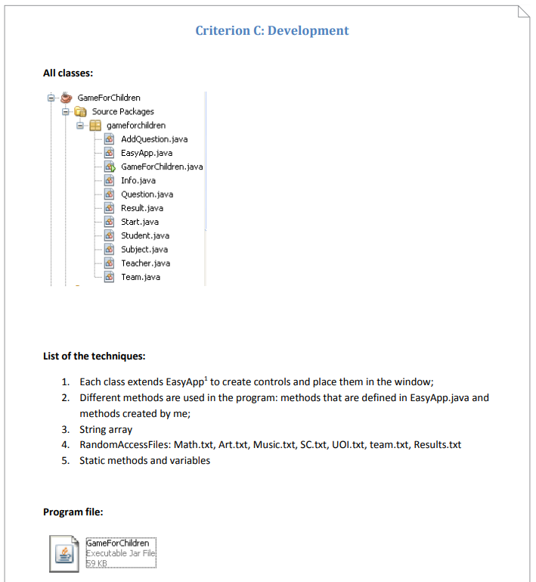
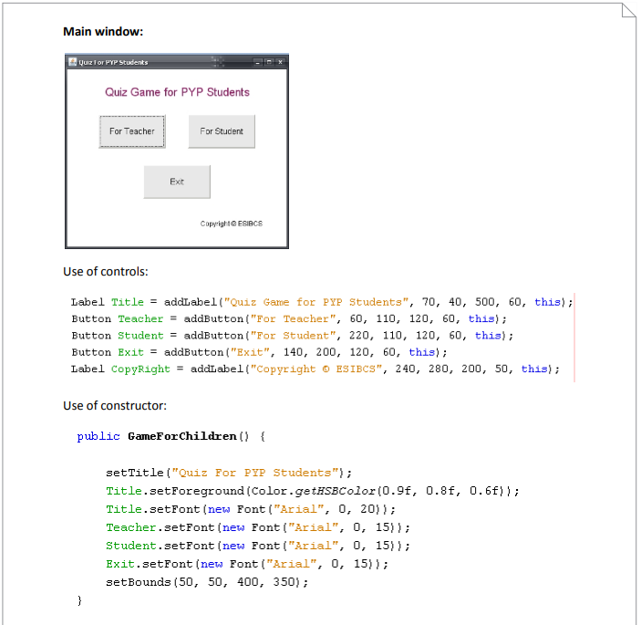
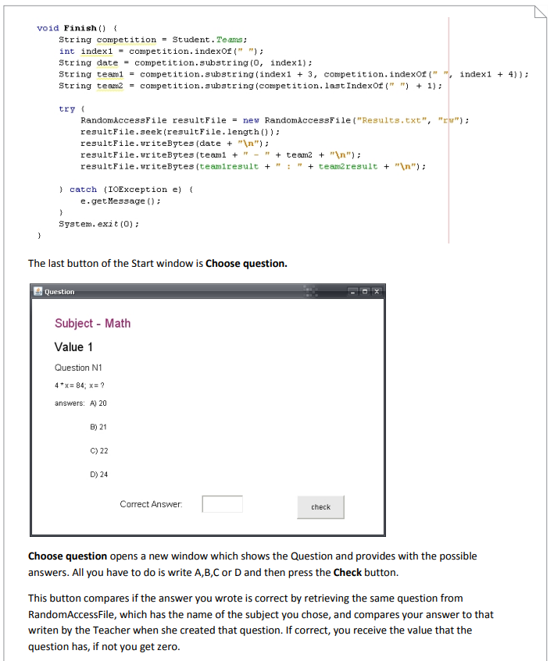
PART TWO: DESIGN OVERVIEW

Slide 7
NOTES
Explain, explain, explain
Use your up to 1000 words as much as possible to explain the complexity of all of the structure of your program
Clear structure
You want to communicate not just your program, but your own personal understanding of these concepts
Showcase your creativity here as well! Show off a bit to make sure the best parts are pointed out.
Your actual code can be included in an appendix

